Slide 1
Pathogenic bacteria.
Dr.Munira Ch. Ismail Lec.14

Slide 2
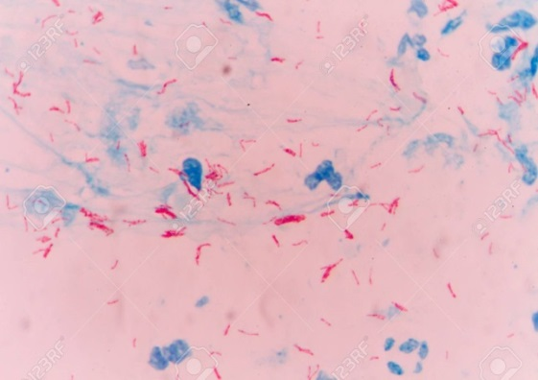
GENUS: MYCOBACTERIA.
Characteristics:
• Non-spore forming, non-motile, aerobic, Acid-fast bacilli.
• Acid-fastness depends on the waxy envelope-mycolic acidmof cell wall.
• More resistant to chemical agents than other bacteria.
• Once stained with primary stain, they resist decolorization by acid-alcohol.
• All bacteria are decolorized by acid-alcohol except Mycobacteria.
. Mycobacteria of medical importance:
M. tuberculosis.
M. leprae.
Mycobacterium tuberculosis.
Characteristics:
. Strictly aerobic acid-fast bacilli.
. The main reservoir is an infected human.

Slide 3
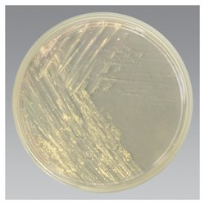
Clinical manifestation:
Incubation period: 4-6 weeks.
Source of infection: Tuberculous patients.
Route of infection: Respiratory- Inhalation of droplet nuclei Ingestion of infected milk.
Disease: Pulmonary and extrapulmonary tuberculosis.
The disease generally manifests with low-grade persistent fever, night sweating, significant weight loss, fatigue and generalized weakness.
Laboratory diagnosis: Identification of M. tuberculosis.
Specimen: Sputum; pleural, peritoneal and cerebrospinal fluid.
Cord forming acid-fast bacilli from culture.
Culture:
1. Semisynthetic agar media.
Smear: Acid fast bacilli from primary specimen.
. Middle brook 7H10 and 7H11.
. Used for observing colony morphology, susceptibility testing, and as selective media.

Slide 4
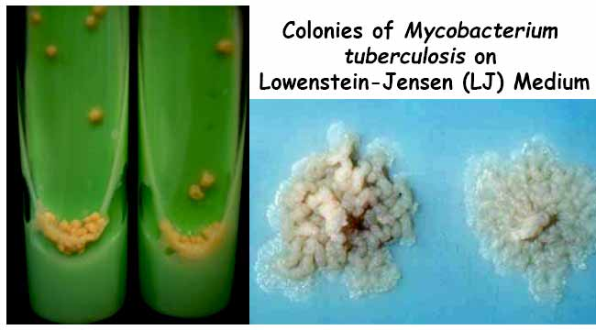
2. Inspissated egg media.
. Lowenstein-Jensen medium.
It is the ordinary selective media for tubercle bacilli
Raised, dry, cream colored colonies of tubercle bacilli after 3-6 wks of incubation.

Slide 5
3. Broth media.
Middle brook 7H9 and 7H12.
. Support the proliferation of small inocula.
Pigment production test:
. Leave the culture in the light for 2 hrs.
. Reincubate it at 35-37 Oc over night.
. Reexamine the colonies for pigment production.
. M. tuberculosis does not produce pigment in dark or light.
Incubation of a subculture at 25Oc
. M. tuberculosis will not grow at 25 Oc.
Growth of the bacteria on Lowenstein-Jensen medium containing
4(P)- nitrobenzoic acid(PNB).
. No growth of M. tuberculosis on PNB media.
Biochemical reaction:
.Niacin test is Positive.
New techniques:
. Molecular probes (DNA probes)- It detects Mycobacterial.
RNA sequence.
. High-performance liquid chromatography.
. Polymerase chain reaction.
. Enzyme immunoassay.

Slide 6
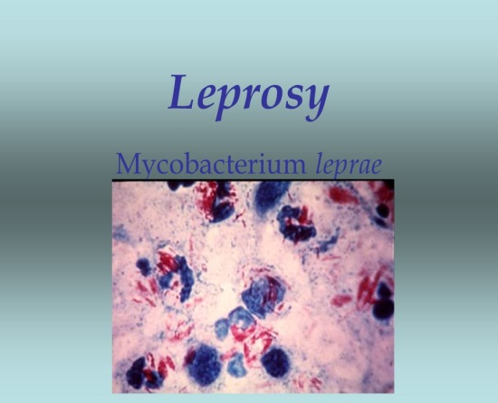
Mycobacterium leprae.
Characteristics:
• Typical acid-fast bacilli, arranged in singly, parallel bundles or in globular masses.
• Not grown in non-living bacteriologic media.
• Characteristic lesions are grown in laboratory animals.
Eg. Foot pads of mice
Armadillos.

Slide 7
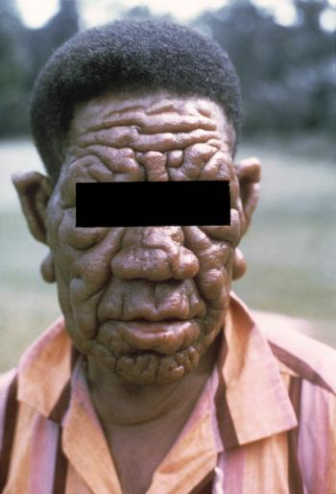
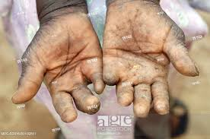
Clinical features:
Incubation period is months to years.
Route of infection is through nasal mucus secretion.
Disease: Hansen’s disease or leprosy.
Leprosy (Hansen's Disease) is a chronic infectious disease that primarily affects the peripheral nerves, skin, upper respiratory tract, eyes, and nasal mucosa (lining of the nose). The disease is caused by a bacillus (rod-shaped) bacterium known as Mycobacterium leprae.
The lesion involves the cooler parts of the body, Eg. Ear lobes.
Clinical triads: Anaesthetic skin patches.

Slide 8
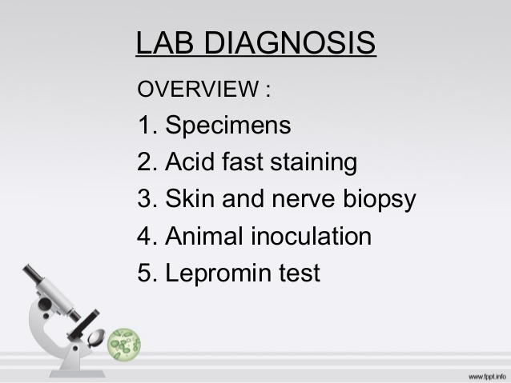
Peripheral neuritis.
Presence of acid-fast bacilli from skin lesion
Laboratory diagnosis:
Specimen: Skin scrapings from the ear lobe.
Smear: Acid fast bacilli from the primary specimen.
Bacterial index (BI) indicates number of organisms present in a smear.
Number of M. leprae bacilli found in smears are related to type of leprosy and effect of drug therapy.

Slide 9
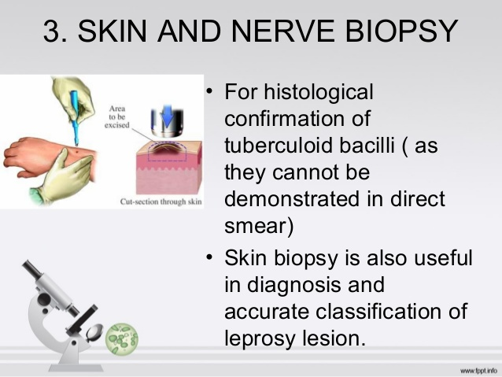
.

Slide 10
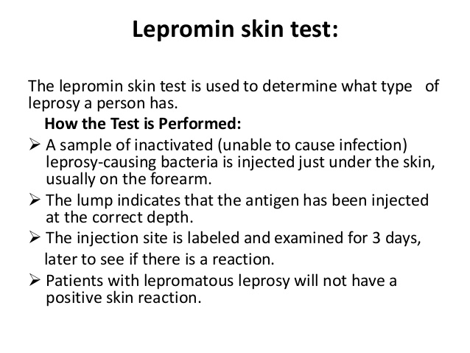
A lepromin skin test is used to determine the type of leprosy a person has contracted. The lepromin skin test is also called the leprosy skin test

Slide 11


